Slide 1
CORDLESS SYSTEM:
DECT, CT2 and PHP
Group no 6;
Name: Registration no:
Maseta, Anyingisye 2009-04-02729
Swela, Malambo 2009-04-05088
Hussein, Hajj 2009-04-01292
Msangi, Abubakari 2009-04-03472
Donatus, Evelyne 2009-04-00827

Slide 2
CORDLESS SYTEM
“Cordless" originates from the technique that made it possible for subscribers to connect a small base station to their telephones, thereby attaining a limited degree of mobility
It is full duplex communication systems that use radio to connect a portable handset and a dedicated Base Station, which is then connected to a dedicated telephone line with a specific telephone number on a Public Switched Telephone Network (PSTN).
Cordless telephone is a telephone with a wireless handset that communicates via radio waves with a base station connected to a fixed telephone line, usually within a limited range of its base station (which has the handset cradle).
There are various generations of cordless system CT0,CT1,CT2,DECT and PHP.

Slide 3

Cordless system configuration
Wireless Link
PSTN
Fixed Port
(Base
Station)
Cordless Handset

Slide 4
CT2
CT2 is a digital FDMA system that uses Time Division Duplexing technology to share carrier frequencies between handsets and base stations.
Features[ of the system are:
Standardized on 864-868 MHz
500 frames/second (alternately base station and handset)
100 kHz carriers
32 kbit/s ADPCM voice channel compression
10 mW maximum power output
GFSK data encoding
Up to 100 meter (300 ft) range
Unlike DECT, CT2 was a voice-only system, though like any minimally-compressed voice system, users could deploy analog modems to transfer data. is fully capable of supporting handoff, unlike DECT it does not support "forward handoff", meaning that it has to drop its former radio link before establishing the subsequent one, leading to a sub-second dropout in the call during the handover.

Slide 5
CT2-principle of operation
Typical CT2 users were sold a handset and base station which they could connect to their own home telephone system. Calls via the home base station would be routed via the home telephone line and in this configuration, the system was identical to a standard cordless phone. When in range, the user could receive incoming calls.
Once out of range of the home, the CT2 user could find signs indicating a network base station in the area, and make outgoing calls (but not receive calls) using the network base station. Base stations were located in a variety of places, including high-streets and other shopping areas, gas stations, and transportation hubs such as rail stations. In this configuration, callers would be charged a per-minute rate higher than if they made calls from home, but not as high as conventional cellular charges.

Slide 6
CT2-usage and performance
Only circuit switched voice services.
Expensive and cannot receive calls.

Slide 7
DECT
DECT is based on Time Division Duplex (TDD) and Time Division Multiple Access (TDMA). It has a TDD/TDMA frame structure.
Operates between 1.88 GHz and 1.9 GHz.
Modulation: GMSK with BT = 0.5
10 carriers in the 1880 - 1900MHz band.
Offers both speech and relatively high data rate transmission capability (<300 kb/s).
Designed for office type scenarios including short range indoor environments.

Slide 8
DECT-principle of operation
A base station (Fixed Part) always transmits its identity information. If no carrier is in use, a special dummy bearer is set up for this purpose. In the unlocked state, the Portable Part (handset) scans the DECT slots and frequencies to find such a transmission from a fixed part. Once it has selected a suitable fixed part, the portable part will synchronize its timing with that of the fixed part and keep listening to identity messages from the fixed part. The portable part is now locked to the fixed part. Note that the fixed part does not know that the portable part is locked.
In DECT the portable part normally initiates setting up a connection. This is done by exchanging a certain set of messages. Once a connection is set up, the fixed part may terminate its dummy bearer as other portable parts can lock to the new traffic bearer. If the fixed part wants to set up a connection, it will page the portable part, which will then initiate the connection set up procedure.

Slide 9
DECT-usage and performance
DECT is well suited to both domestic and business use. Its dynamic channel allocation and digital voice coding provide a voice quality comparable to a landline, while its ability to hand over between base stations make DECT a prime candidate for larger sites, such as offices or industrial buildings.
In addition to home and business use, several extensions to the standard enable DECT to be used as a public access service (CTM - Cordless Terminal Mobility) and a Wireless Local Loop (WLL)
Is designed to be compatible with many other types of network, such as the PSTN (conventional telephone networks), ISDN (new digital and data phone networks), GSM (mobile phone networks) and more.

Slide 10
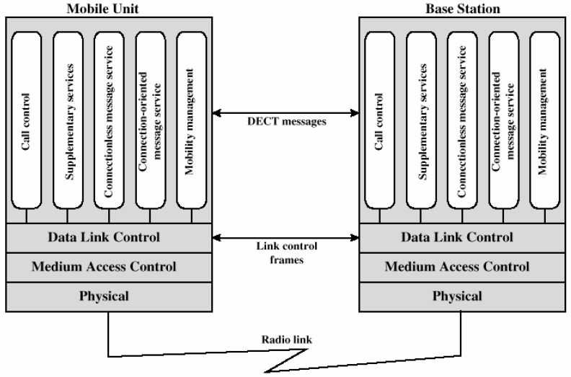
DECT Protocol Architecture

Slide 11
DECT Protocol Architecture
Physical layer
– data transmitted in TDMA-TDD frames over one of 10 RF carriers
• Medium access control (MAC) layer
– selects/ establishes/releases connections on physical channels;
supports three services:
• Broadcast
• Connection oriented
• Connectionless
Data link control layer
– provides for the reliable transmission of messages using traditional data link control procedures

Slide 12
Personal Handy Phone System (PHS)
Formerly PHP Developed in Japan. Debuted in 1995. Offered two-way communications, data services and Internet access.
Features:
PHS cells are small
With transmission power of base station a maximum of 500 mW
Range typically measures in tens or at most hundreds of meters (some can range up to about 2 kilometers in line-of-sight)
Uses TDMA/TDD for its radio channel access method, and 32 kbit/s ADPCM for its voice codec.

Slide 13
PHS-usage and performance
PHS is essentially a cordless telephone like DECT, with the capability to handover from one cell to another. This makes PHS suitable for dense urban areas, but impractical for rural areas, and the small cell size also makes it difficult if not impossible to make calls from rapidly moving vehicles
Modern PHS phone support many value-added services such as high speed wireless data/ Internet connection (64 kbit/s and higher), WWW access, e-mailing, text messaging and even color image transfer.
In spite of its low-cost base station, micro-cellular system and "Dynamic Cell Assignment" system, PHS offers higher number-of-digits frequency use efficiency with lower cost (throughput per area basis), compared with typical 3G cellular telephone systems

Slide 14
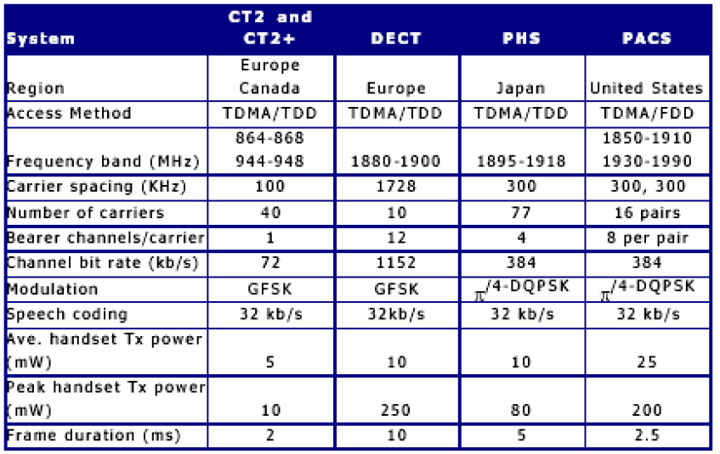
2G Digital Cordless specifications

Slide 15
Cordless system in Tanzania
There are very few homes in Tanzania that use CT2 system due to decline (poor infrastructure) of landline trunks.
DECT is much used in many offices like Bank, Industries and companies.
PHS Declined due to decreasing costs of full cellular service.

Slide 16
References
http://en.wikipedia.org/wiki/Cordless_telephone.
http://en.wikipedia.org/wiki/Personal_Handy-phone_System.
http://www.wirelesscommunication.nl/reference/chaptr01/telephon/dect.htm
Introduction to wireless communication systems
TE412 lecture notes, 2008

